Slide 1




G20 Summit 2023 Analysis
Welcome to the world of Natural Language Processing (NLP), where we analyze the G20 summit 2023 hosted in India using advanced language processing techniques.
by Sharvaree Raut

Slide 2

Objective
The main goal of our NLP project is to extract valuable insights from the Comments of people and PM's speech on G20 summit 2023, and provide a comprehensive analysis of key themes and sentiments.

Slide 3

Overview of G20 Summit 2023
1
Global Cooperation
2
Hosted in India
3
Key Participants
In 2023, India had the privilege of hosting the G20 summit, providing a platform for discussions on economic growth, international trade, and more.
Leaders from G20 member countries, guest countries, international organizations, and representatives from various sectors will participate.
The G20 summit is a gathering of leaders from the world's major economies to discuss and coordinate on important global issues.

Slide 4

Importance of Natural Language Processing
Natural Language Processing allows us to analyze large volumes of textual data from speeches, press releases, and social media posts to gain valuable insights and patterns.
Text analysis and Sentiment analysis can be done using NLP

Slide 5
Workflow and Step-wise Procedure
1
Data Collection
Gather speeches, press releases, and other relevant documents from the G20 summit.
Data Preprocessing
2
Clean and preprocess the collected data to remove noise, punctuation, and perform text normalization.
3
NLP Techniques
Apply advanced NLP techniques, including sentiment analysis and word cloud generation, to extract meaningful information.

Slide 6

Detailed Steps
Extract speeches from the Official website of G20 and Comments of People under the News of this summit
Lowercase the text, Remove numbers, URLs, punctuation, stop words, common words, extra white space and lemmatize the dataset for analysis.
Term Document Matrix
Word cloud/Bar plot
Sentiment Analysis

Slide 7

NLP Techniques Used
Sentiment Analysis
Word Cloud
Analyze the sentiment expressed in the speeches and statements to understand the emotional tone of the discussions.
Create visually appealing word clouds to visualize the most frequently used words and key themes discussed.

Slide 8
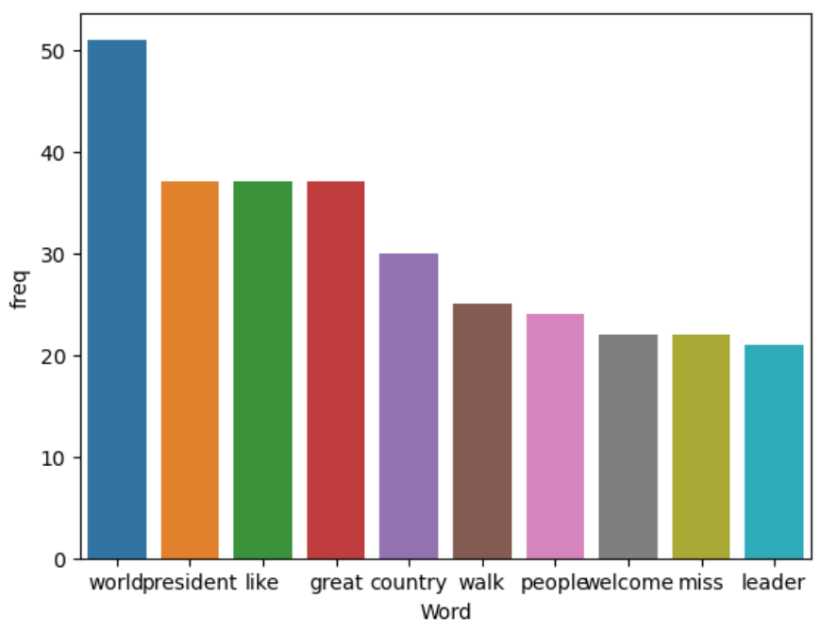
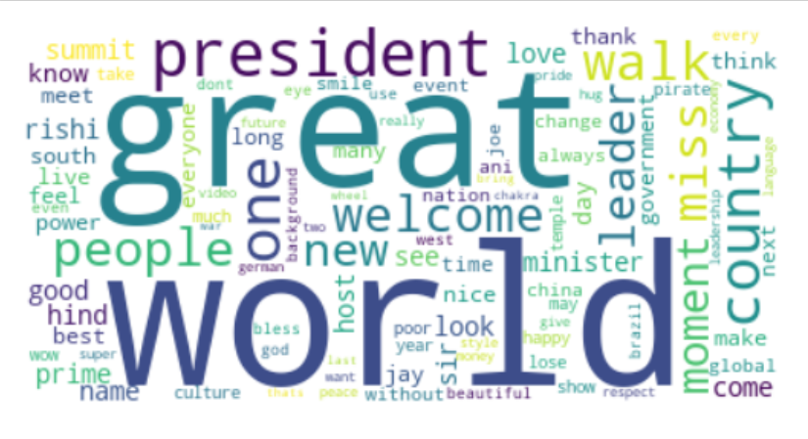
Text Analysis on Public Comments

Slide 9
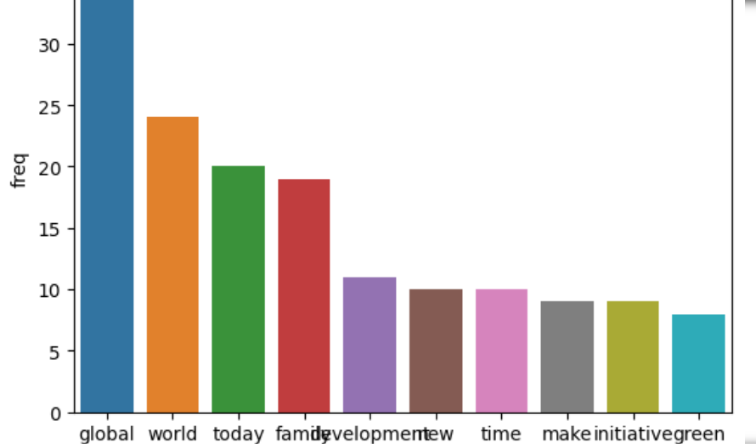

Text Analysis on PM’s Speech

Slide 10
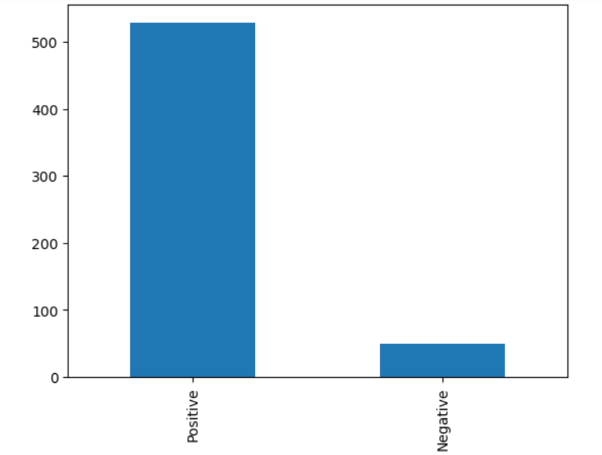
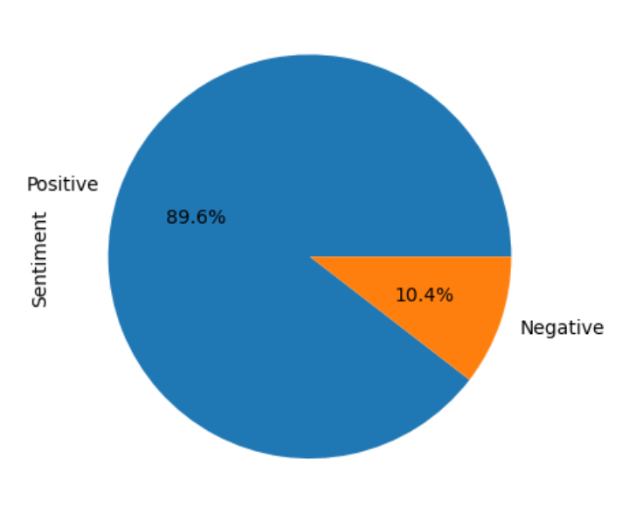
Sentiment Analysis

Slide 11

Insights
By applying NLP techniques, we discovered important insights related to global cooperation, economic policies, trade, action on terrorism, climate and sustainable development goals discussed at the G20 summit.

Slide 12
Advantages
1
Efficiency and Scalability
2
Uncovering Hidden Patterns
3
Data-Driven Decision Making
NLP enables quick analysis of large volumes of textual data, ensuring efficient extraction of insights.
NLP techniques reveal hidden patterns and correlations that may not be obvious through manual analysis.
The insights derived from NLP analysis can inform evidence-based decision making at the global level.

Slide 13

Applications
1
Policy Formulation
2
Social Media Monitoring
NLP analysis helps policymakers in formulating effective strategies and policies based on insights from the summit.
Monitoring social media discussions around the G20 summit using NLP helps gauge public sentiment and feedback.
3
Media Reporting
NLP analysis aids media organizations in reporting the key themes and sentiments emerging from the summit more accurately.

Slide 14

Conclusion and Future Implications
Our NLP project on the G20 summit 2023 in India provides valuable insights for policymakers, researchers, and the general public. It sets the stage for future NLP-based analysis of important global events.

Slide 15
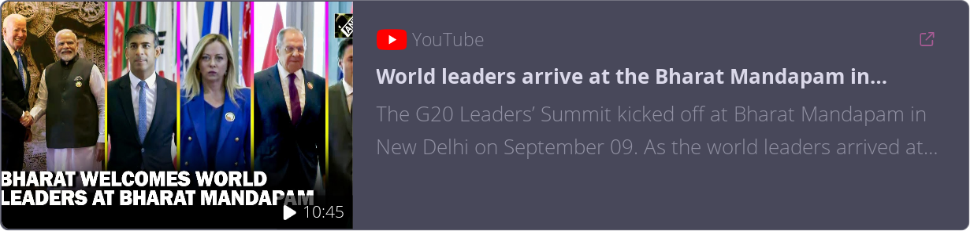
References
G20 summit official website
Notes on NLP techniques
ANI news video

Slide 16

Thank You!

